Slide 1
One Dimensional Motion
Holt Physics Chapter 2

Slide 2
What is a dimension?
A way in which we can measure the world

Slide 3

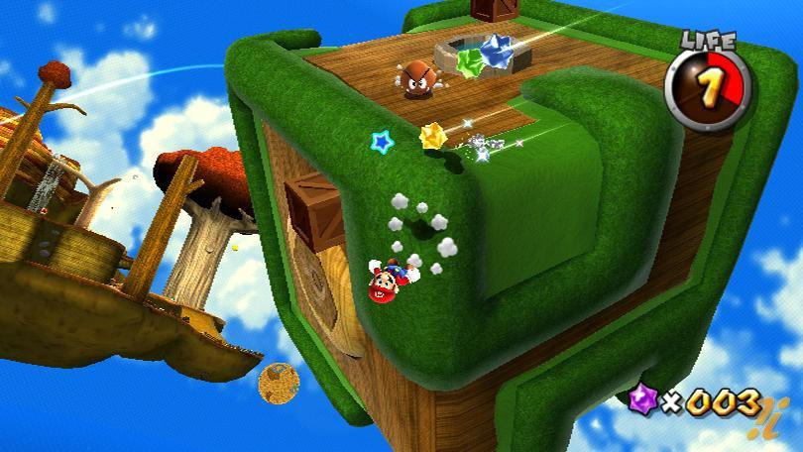
One, Two and Three dimensions
A single dimension is all that can be measured by a meter stick – a straight line
  left/right
A two dimensional world can be thought of as the Super Mario Brothers world
  left/right
  up/down
A three dimensional world is what Newton envisioned, or like a modern video game
  left/right
  up/down
  forward/back

Slide 4
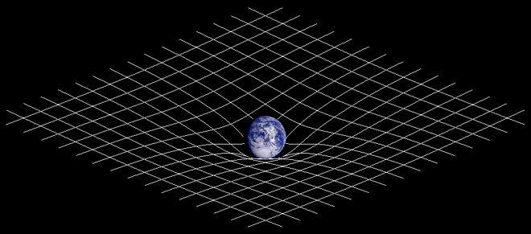
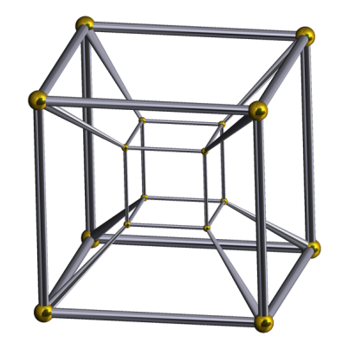
Four Dimensions
The modern view of our universe is one that places us in four dimensions, a quite puzzling phenomenon
  The first three dimensions are the traditional concept of space
    X,Y,Z dimensions
  The fourth dimension is time
  This view brings us space-time, which helps simplify our model of the universe when integrating some of Einstein's ideas about general relativity
For mathematical simplicity, we will restrict ourselves to only one or two dimensions
A 2-D simplification of the space-time gravity well around our planet
To the left is a 2-D picture of a 3-D shape that is the shadow of a 4-D object. Complex, yes?
Its called a Tesseract.

Slide 5
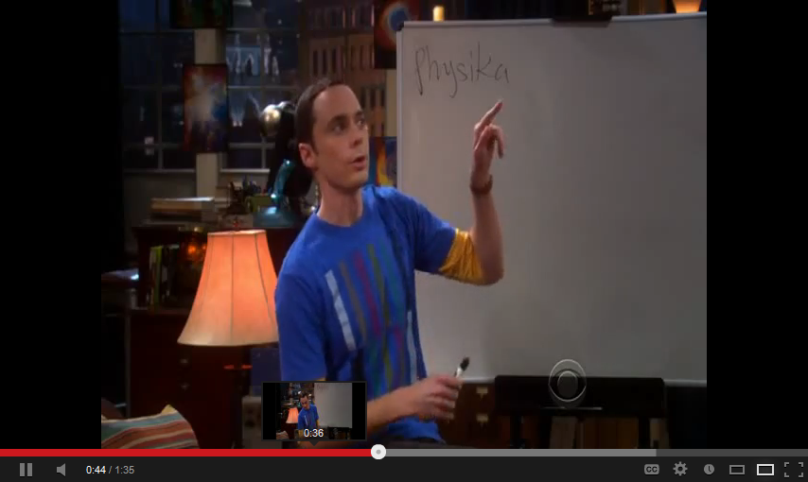
Motion in one dimension
The very simplest form of Newtonian Mechanics with a three phase introduction to the quintessential mathematical thinking of physics

Slide 6
Key Terms
Frame of reference
  Coordinate system imposed on a situation
Position
  Location within a frame of reference
Distance
  Total length traveled
Displacement
  A change in position
  Length traveled in a specified direction
Speed
  A rate of change of position, regardless of direction
Velocity
  The generic term for the rate of displacement
Average velocity
  The total displacement divided by the time it took to occur
Instantaneous velocity
  A measure of velocity, over an infinitesimal amount of time
Acceleration
  The rate of change of velocity with in a given time interval
Free fall
  The state of falling and being only influenced by gravity

Slide 7
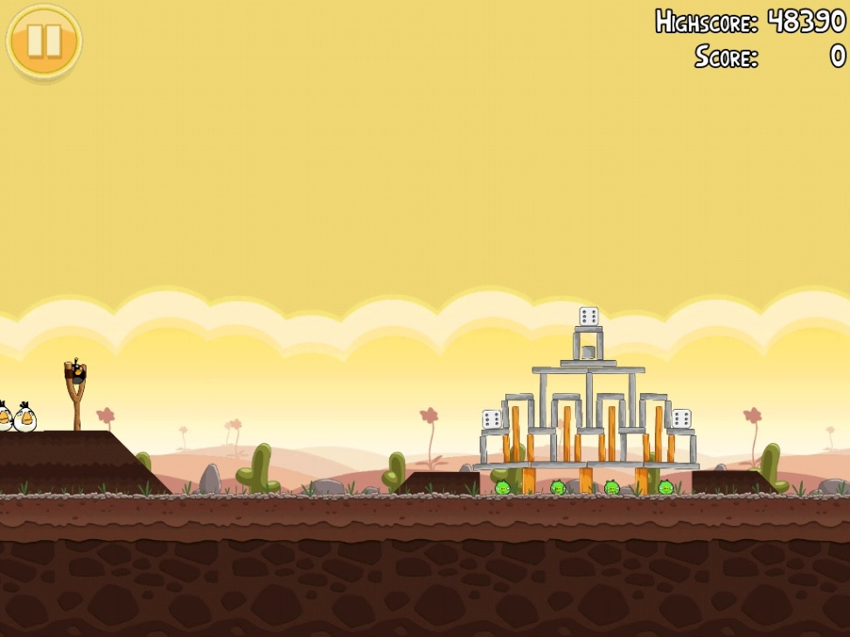
Phase one: The Set-up
The first step to introducing yourself to physics is to impose a coordinate system on everything
  You will need to establish a frame of reference that is consistent to more easily describe a scenario
0
1
2
3

Slide 8
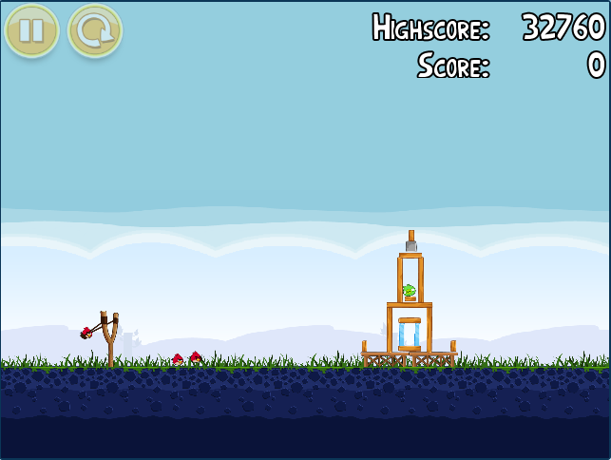
Phase two: Getting used to Numbers
Once the frame of reference is imposed, measurements can be made to describe location and motion
  The position of the red bird in the slingshot is 0.2m on the coordinate system
  The green pig is in the tower at 2.8m
  The tower spans from 2.5m to 3.2m, making it 0.7m wide
0
1
2
3

Slide 9
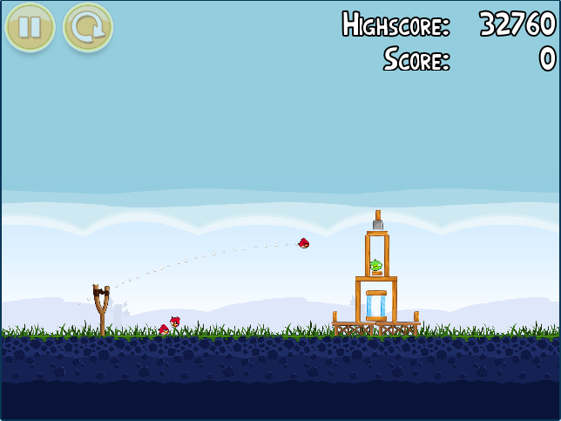
Phase Three: Time for Physics
Position describes where something is in the frame
Displacement describes where something has moved in the frame
  The red bird has had a displacement of 2.0m right (or +2.0m)
The total displacement divided by the travel time is the average velocity
0
1
2
3
Note: The distance the red bird traveled is over 2.0m, but here displacement is only a measure of our 1-D distance from A to B
*There will be 2-D displacements in the future

Slide 10
Vectors
A way to signify magnitude and direction

Slide 11
Introduction to Vectors
Scalar Values
Vector Values
“Normal Numbers”
Numbers that only denote magnitude, without direction
Common for most mathematical applications
Speed, Distance and Time are best described by scalar values
  These values can also be used with vectors when needed
Numbers that are inextricably tied to a direction
  The directionality of vectors is a reminder of the importance of directions in physics
Vectors make up an entire branch of mathematics
  mathematicians use vectors since they can convey two pieces of information at once
Position, Displacement, Velocity and Acceleration are all best described by vectors

Slide 12
Position and Displacement
Location and motion from one place to another

Slide 13
Position
Position describes the location of an object within the predetermined frame of reference
Position is described by a vector, and therefore has two parts
    The distance from the origin of the frame of reference
    The direction from the origin of the frame of reference
      The red bird is 0.2m right of the origin
0
1
2
3
Position is in equations as the symbol ‘x’

Slide 14
Displacement
Displacement describes how far and in what direction an object has moved
Displacement is described by a vector, and therefore has two parts
    The distance between the initial and final locations
    Net direction of the motion needed to move from the initial to final positions
      The red bird moved 2.0m to the right
Direction can be shown with a simple + or - sign
0
1
2
3
Displacement is in equations as the symbol ‘Δx’

Slide 15
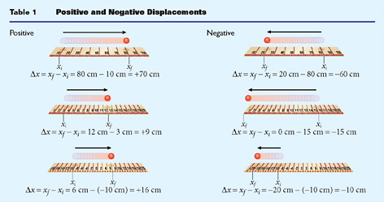
Positive and Negative Displacement
Usually reference frames are set-up so that the right is positive and the left is negative
  This means that moving to the right is positive, to the left is negative
    Consider this when moving across zero, within location values below zero and within values above zero
Sometimes atypical reference frames can throw a wrench in the regularity of things, and more attention is needed
  Be wary of the backwards frames and vertical frames

Slide 16
The Two ‘D’ Words
Distance
B
Displacement
A
Distance
Displacement
The total length traveled by an object
Direction is irrelevant
Sometimes it is the same as the absolute value of displacement
The distance from where an object starts moving, to where it stops
The direction of the motion

Slide 17
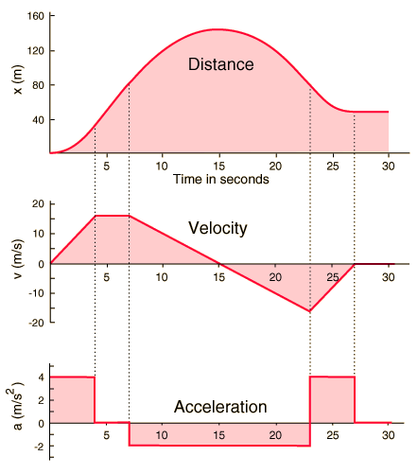
Graphing motion
It can be valuable to graph an objects displacement over time, as another way to see where it has been
  What does the slope of this line mean?
  What is the area under the curve signify?
Enter Calculus!

Slide 18
Velocity in all forms
The rate of displacement

Slide 19
General Velocity
Velocity is the rate of displacement
  Consider the speed at which you run or walk a mile
    Both are a mile in length (the same displacement)
    Walking takes much longer, so the velocity is lower
Velocity is the first derivative of displacement, the slope of f(x)

Slide 20
“Let’s See How this Goes”
Quiz Time!
(Don’t worry – its not for points)

Slide 21
Problem Solving Strategy
Draw a picture
  This helps to ensure that you understand the ideas conveyed by the story problem
Pullout the important information from the text
  You can list these, put them in the picture, or both
Determine which equation(s) to use
  Check what variables you need and have
Algebraically arrange the equation for your desired variable
Plug in numbers and solve the problem!

Slide 22
Velocity Practice
A person rides their bike for 3 hours in the park. They know, because of the mile markers that they passed, that they rode for 35 miles. What was their average speed in miles per hour?

Slide 23
Velocity Practice
A horse runs down a path at 7m/s to the east. If he continues to run for 720s, how far has the horse traveled?

Slide 24
Velocity Practice
You need to drive 583km to Chicago, because your sister is having a baby there. If the speed limit is 95km/hr and, on average, you travel at that rate, how long will it take you to arrive?

Slide 25
Average Velocity
‘Average velocity’ is the mathematically correct way to find the average velocity
  The total displacement of an object divided by the total time of the displacement
    There are some scenarios where it may be tempting to find average velocity another way. Do not be fooled!

Slide 26
Average Velocity
You are running in a 10K race. You know that it only took you 54min to complete, but now you are wondering what your average velocity was.

Slide 27
Average Speed
‘Average speed’ is the mathematically correct way to find the average speed
  The total distance traveled by an object divided by the total time of the travel
    There are some scenarios where it may be tempting to find average speed another way. Do not be fooled
  Note: displacement and speed are NOT the same.

Slide 28
Instantaneous Velocity
The instantaneous velocity is the velocity at a given instant, which is easily thought about but needs calculus to be found

Slide 29
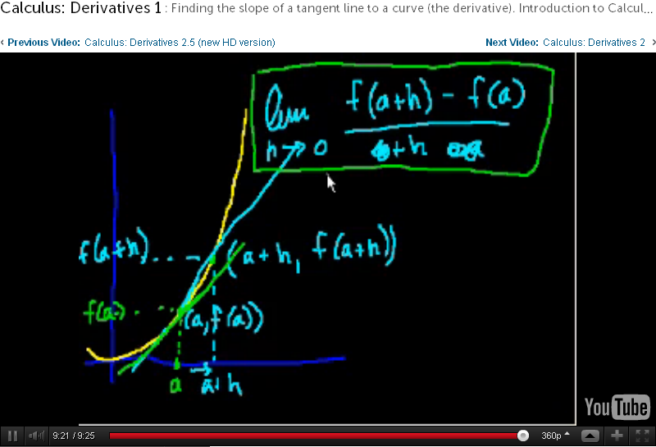
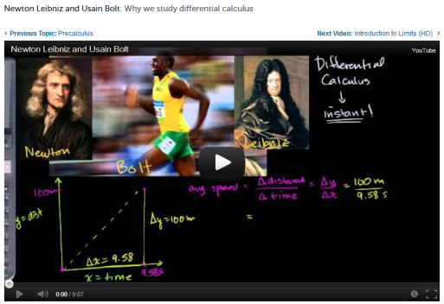
A Brief Definition of Calculus
Isaac Newton developed calculus to solve the problems encountered in physics
The ideas in physics are clearly derived from calculus, and often the calculus versions of the equations are simpler to understand
  Since this is not a calculus-based physics course, we will only require algebra
Calculus uses a simple limit as a tool for a fundamentally new way to think about functions
  Derivatives and Integrals are wildly useful, as you will see
Khan Academy is a wonderful resource, and provides a straightforward proof of calculus that can be good to know from this point forward in Physics

Slide 30
Acceleration
The rate of change in velocity

Slide 31
The Definition of Acceleration
Acceleration is the rate of change in velocity
  Just like the position can change over time, the velocity can change
  Don’t forget: a change in something is the final value minus the initial value

Slide 32
The Definition of Acceleration
Acceleration is the second time derivative of the position-time function
  That is where the m/s² comes from
  (derivative) The line for acceleration is the slope of the velocity graph
  (integral) The area ‘under’ the acceleration graph up to a given point is the velocity at that point

Slide 33
Problem Solving Strategy
Draw a picture
  This helps to ensure that you understand the ideas conveyed by the story problem
Pullout the important information from the text
  You can list these, put them in the picture, or both
Determine which equation(s) to use
  Check what variables you need and have
Algebraically arrange the equation for your desired variable
Plug in numbers and solve the problem!

Slide 34
Acceleration Practice
In 1935, a French destroyer, La Terrible, attained one of the fastest speeds for any standard warship. Suppose it took 2.0 min at a constant acceleration of 0.19 m/s² for the ship to reach its top speed after starting from rest. Calculate the ship’s final speed.
(B prob2)
23m/s

Slide 35
Acceleration Practice
An automobile that set the world record for acceleration increased speed from rest to 96 km/h in 3.07 s. How far had the car traveled by the time the final speed was achieved?
(C prob 6)
41 m

Slide 36
Acceleration Practice
Alfred gave Batman a jetpack (since Batman can’t fly). To try it out, Batman stands at the bottom of a 30m tall building and jets up to the roof in 15s. What is the acceleration of the jetpack?
0.267m/s²

Slide 37
Acceleration Practice
A drag race is a 500m race, and in that small space two racers try and accelerate their vehicles as much as possible. If a modified vehicle has an acceleration of 30m/s², what is the final velocity of the racecar?
About 173 m/s

Slide 38
Acceleration Practice
The highest speed achieved by a standard non-racing sports car is 3.50×10² km/h. Assuming that the car accelerates at 4.00 m/s², how long would this car take to reach its maximum speed if it is initially at rest? What distance would the car travel during this time?
(D prob 9)
24.3s 1.18km

Slide 39
Acceleration Practice
In 1986, the first flight around the globe without a single refueling was completed. The aircraft’s average speed was 186 km/h. If the airplane landed at this speed and accelerated at -1.5 m/s², how long did it take for the airplane to stop?
(D prob 1)
34s

Slide 40
Acceleration Practice
In 1993, bicyclist Rebecca Twigg of the United States traveled 3.00 km in 217.347 s. Suppose Twigg travels the entire distance at her average speed and that she then accelerates at –1.72 m/s² to come to a complete stop after crossing the finish line. How long does it take Twigg to come to a stop?
(B prob 9)
8.02s

Slide 41
Acceleration Practice
With a cruising speed of 2.30×10³ km/h, the French supersonic passenger jet Concorde is the fastest commercial airplane. Suppose the landing speed of the Concorde is 20.0 percent of the cruising speed. If the plane accelerates at –5.80 m/s², how far does it travel between the time it lands and the time it comes to a complete stop?

Slide 42
Acceleration Practice
The lightest car in the world was built in London and had a mass of less than 10 kg. Its maximum speed was 25.0 km/h. Suppose the driver of this vehicle applies the brakes while the car is moving at its maximum speed. The car stops after traveling 16.0 m. Calculate the car’s acceleration.

Slide 43
Displacement | Δx |  | Unused Variable
Initial Velocity | V_{i}
Final Velocity | V_{f} |  |  | Unused Variable
Acceleration | a | Unused Variable
Time | Δt |  |  |  | Unused Variable
 |  | Δx=½(v_{i}+v_{f}) Δt | V_{f}=v_{i}+aΔt | Δx=v_{i}Δt+½aΔt² | V_{f}²=V_{i}² +2aΔx
Derive these from the 2 definitions!
Reorganized By Andrea Kutcha!

Slide 44
Acceleration due to gravity

Slide 45
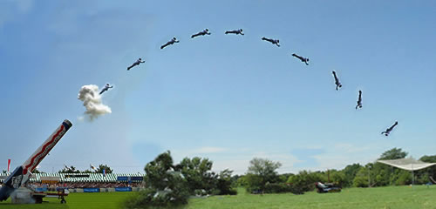
Acceleration due to Gravity (Freefall)
Gravity is a force that is relatively consistent on the surface of the Earth, and we will begin to apply these regularities in class

Slide 46
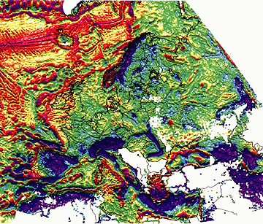
Acceleration due to Gravity
Gravity is the force that pulls any two objects with mass toward on another
On the surface of Earth, it is felt as a constant downward pull
  At sea level this is effectively a downward acceleration of 9.8m/s²
The small variations of gravity across Europe.
Gravity changes with altitude, and distribution of mass (a non-uniform density) within the Earth.

Slide 47
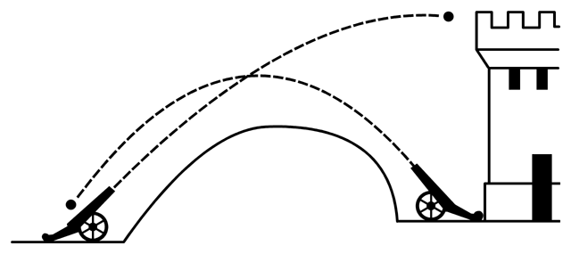
Acceleration due to Gravity
Objects that are in freefall will have a vertical velocity of Zero at the top of their flight path
An object thrown upward will have the same magnitude (but opposite) vertical velocity a the same height coming downward
We will soon see that the X & Y components are separate

Slide 48
Things to know for most freefall problems
Acceleration will be g: -9.8m/s²
Anything that is “dropped” has an initial vertical velocity of zero
At the same height in a continuous flight path, an object will be traveling at the same speed (and the opposite direction)
Unless an object is going straight up and down, the object in freefall will always travel through some segment of a parabola
At the top of a parabolic flight path the vertical velocity of the object is zero for an instant

Slide 49
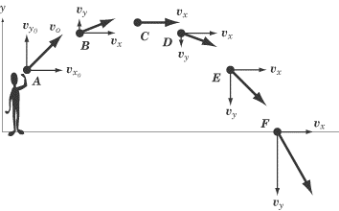
The same things to know (don’t write)
Acceleration will be g: -9.8m/s²
Anything that is “dropped” has an initial vertical velocity of zero
At the same height in a continuous flight path, an object will be traveling at the same speed (and the opposite direction)
At the top of a parabolic flight path the vertical velocity of the object is zero for an instant

Slide 50
Freefall Practice
In a scientific test conducted in Arizona, a special cannon called HARP (High Altitude Research Project) shot a projectile straight up. If the projectile’s initial speed was 3000 m/s, how long did it take the projectile to reach its maximum height? What is the maximum height?
(c prob 2- modified)
X s

Slide 51
Freefall Practice
The John Hancock Center in Chicago is the tallest building in the United States in which there are residential apartments. The Hancock Center is 343 m tall. Suppose a resident accidentally causes a chunk of ice to fall from the roof. What would be the velocity of the ice as it hits the ground? Neglect air resistance.
(F Prob 1)
- 82.0 m/s

Slide 52
Freefall Practice
Brian Berg of Iowa built a house of cards 4.88 m tall. Suppose Berg throws a ball from ground level with a velocity of 9.98 m/s straight up. What is the velocity of the ball as it first passes the top of the card house?
(F Prob 2)
± 1.97 m/s

Slide 53
Freefall Practice
The Sears Tower in Chicago is 443 m tall. Suppose a book is dropped from the top of the building. What would be the book’s velocity at a point 221 m above the ground? Neglect air resistance.
(F Prob 3)
-66.0 m/s

Slide 54
Freefall Practice
The tallest roller coaster in the world is the Desperado in Nevada. It has a lift height of 64 m. If an archer shoots an arrow straight up in the air and the arrow passes the top of the roller coaster 3.0 s after the arrow is shot, what is the initial speed of the arrow?
(F Prob 4)
36 m/s

Slide 55
Freefall Practice
The tallest Sequoia sempervirens tree in California’s Redwood National Park is 111 m tall. Suppose an object is thrown downward from the top of that tree with a certain initial velocity. If the object reaches the ground in 3.80 s, what is the object’s initial velocity?
(F Prob 5)
-10.6 m/s

Slide 56
Freefall Practice
The Westin Stamford Hotel in Detroit is 228 m tall. If a worker on the roof drops a sandwich, how long does it take the sandwich to hit the ground, assuming there is no air resistance? How would air resistance affect the answer?
(F Prob 6)
6.82 s

Slide 57
Freefall Practice
A man named Bungkas climbed a palm tree in 1970 and built himself a nest there. In 1994 he was still up there, and he had not left the tree for 24 years. Suppose Bungkas asks a villager for a newspaper, which is thrown to him straight up with an initial speed of 12.0 m/s. When Bungkas catches the newspaper from his nest, the newspaper’s velocity is 3.0 m/s, directed upward. From this information, find the height at which the nest was built. Assume that the newspaper is thrown from a height of 1.50 m above the ground.
(F Prob 7)
8.38 m

Slide 58
Freefall Practice
Rob Colley set a record in “pole-sitting”when he spent 42 days in a barrel at the top of a flagpole with a height of 43 m. Suppose a friend wanting to deliver an ice-cream sandwich to Colley throws the ice cream straight up with just enough speed to reach the barrel. How long does it take the ice-cream sandwich to reach the barrel?
(F Prob 8)
3.0 s

Slide 59
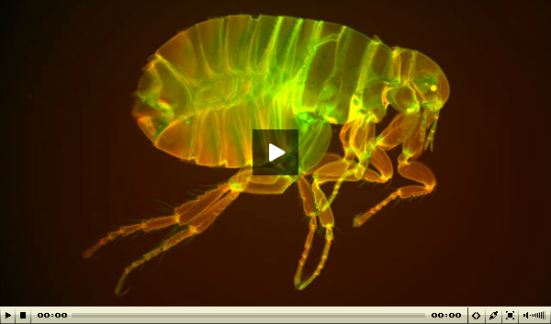
Freefall Practice (Quadratic for Δt)
A common flea is recorded to have jumped as high as 21 cm. Assuming that the jump is entirely in the vertical direction and that air resistance is insignificant, calculate the time it takes the flea to reach a height of 7.0 cm.
(F Prob 9)
0.04 s

Slide 60
Motion-Time Graphing
Graphing position, velocity and acceleration over a period of time.

Slide 61
Motion-Time Graph
Describing motion is occasionally difficult to do with words
Graphs can help simplify this description greatly
  Position = Distance from a starting point
  Velocity = rate of change in position
  Acceleration = rate of change in velocity

Slide 62
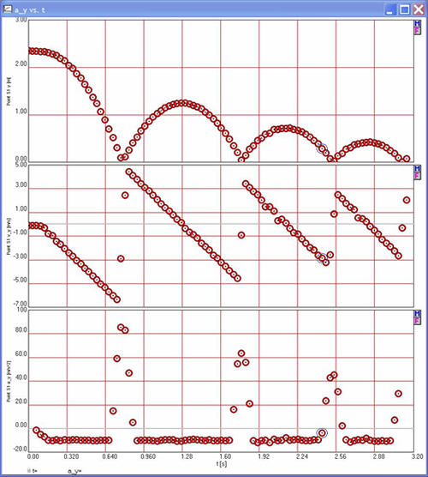
The Derivative and Integral
The slope of a curve has a physical meaning
  For a position-time graph
    y-axis measures meters (m)
    X-axis measures time (s)
  Slope is the rise over run (or Δy/Δx)
    This turns out to be m/s
  Slope is the derivative
The area under the curve has a meaning
  For a velocity-time graph
    y-axis measures velocity (m/s)
    X-axis measures time (s)
  Area for a square is L × W
    This means area is (m/s)×(s) which equals m
  Area under the curve is the integral
The text to the right of the red box is recommended, not required

Slide 63
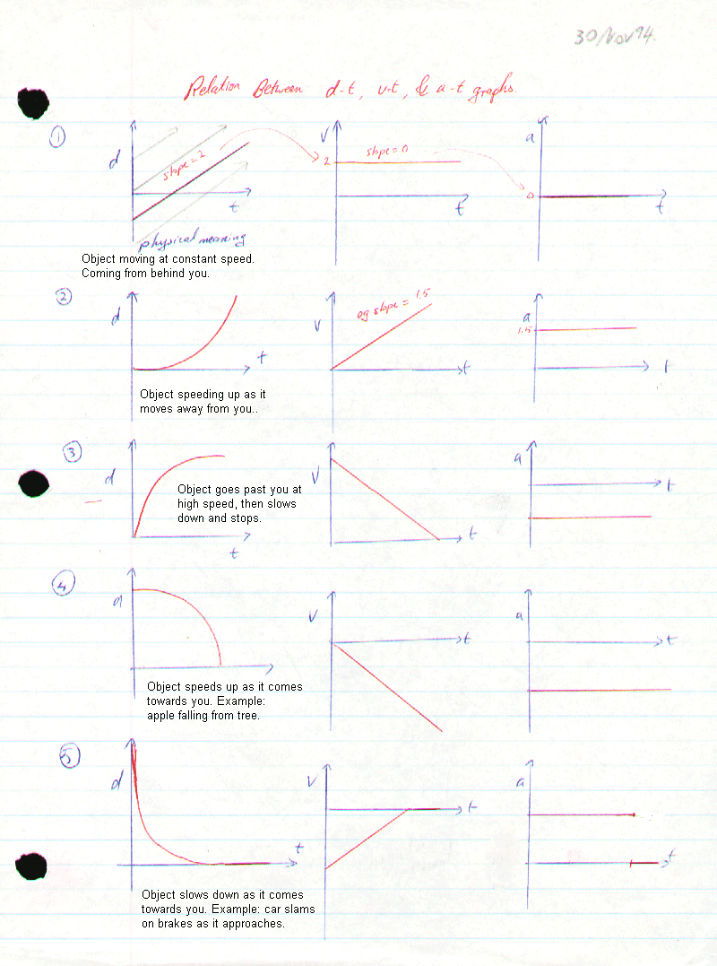
More examples
Check it out!

Slide 64
Motion type 1: Standing Still
X (t)
V (t)
a (t)
0
0
0
t
t
t
The object is in one location over time
The velocity must be zero
The acceleration must be zero

Slide 65
Motion type 2: Moving Away
X (t)
V (t)
a (t)
0
0
0
t
t
t
The object is moving consistently away
The velocity is constant and positive
The acceleration is zero (constant velocity)

Slide 66
Motion type 3: Moving Toward
X (t)
V (t)
a (t)
0
0
0
t
t
t
The object is moving consistently to
The velocity is constant and positive
The acceleration is zero (constant velocity)

Slide 67
Motion type 4: Away, Slowing Down
X (t)
V (t)
a (t)
0
0
0
t
t
t
The object is moving away from the origin. Fast to begin with, then slowing its motion as time passes.
The velocity is decreasing towards zero at a constant rate over time (slowing down)
The acceleration is constant and negative

Slide 68
Motion type 5: Toward, Speeding Up
X (t)
V (t)
a (t)
0
0
0
t
t
t
The object is moving toward the origin. slow to begin with, then quickening its motion as time passes.
The velocity increasing away from zero at a constant rate over time (speeding up)
The acceleration is constant and negative

Slide 69
Motion type 6: Toward, Slowing Down
X (t)
V (t)
a (t)
0
0
0
t
t
t
The object is moving toward the origin. Fast to begin with, then slowing its motion as time passes.
The velocity ‘increasing’ towards zero at a constant rate over time (slowing down)
The acceleration is constant and positive

Slide 70
Motion type 7: Away, Speeding Up
X (t)
V (t)
a (t)
0
0
0
t
t
t
The object is moving away from the origin. Slow to begin with, then quickening its motion as time passes.
The velocity increases away from zero at a constant rate over time (speeding up)
The acceleration is constant and positive

